Slide 1
LINE CODING

Slide 2
Baseband shaping for Data transmission
So far we discussed various techniques for converting an analog signal into digital form.
Another way in which digital data can arise in practice
Eg. A digital computer.
When digital data (of what ever origin) are transmitted through a band-limited channel,
Dispersion in the channel causes an overlap in time b/w successive symbols.

Slide 3
Cont..
This form of distortion is known as intersymbol interference.
If it is not controlled creates serious problem to the quality of received signal.
Here will see the techniques that enable perfect reception in absence of noise.
Techniques are based on shaping the baseband response of the system.

Slide 4
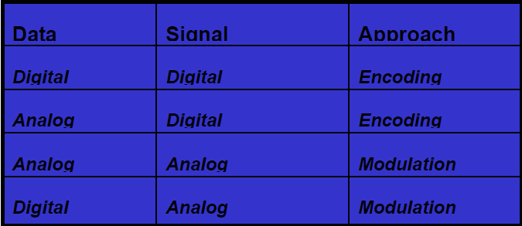
Various approaches for conversion of data to signal

Slide 5
Data & Signal Element
A data element is the smallest entity that can represent a piece of information. i.e.bit
In digital data communication, a signal element carries data element.
Signal element is the shortest unit of digital signal.

Slide 6
Data rate & Signal rate
Data rate: no. of data elements (bits) sent in one second.
Unit : bits per second (bps)
Data rate sometimes called bit rate
Signal rate: no. of signal elements sent in one second.
Unit: baud
Signal rate as pulse rate, modulation rate , baud rate

Slide 7
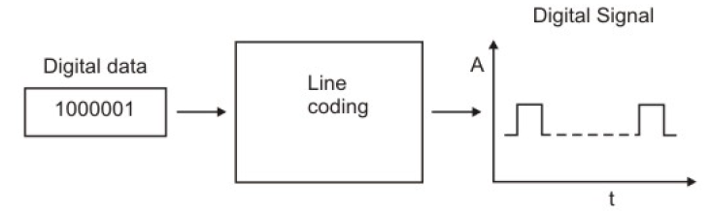
Line Coding
This approach converts digital data to digital signal, known as line coding.

Slide 8
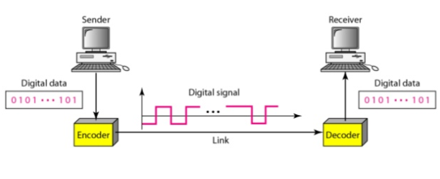
Line Coding & Decoding

Slide 9
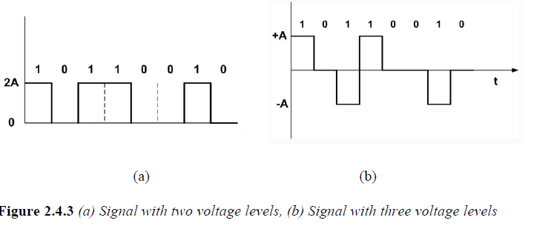
Line Coding Characteristics
Important parameters of line coding techniques are:
No of signal levels: This refers to the number values allowed in a signal, known as signal levels, to represent data.

Slide 10
Line Coding Characteristics
Bit rate versus Baud rate: The bit rate represents the number of bits sent per second,
Baud rate defines the number of signal elements per second in the signal.
Depending on the encoding technique used, baud rate may be more than or less than the data rate.

Slide 11
Line Coding Characteristics
DC components: After line coding, the signal may have zero frequency component in the spectrum of the signal, which is known as the direct-current (DC) component.
DC component in a signal is not desirable because the DC component does not pass through some components of a communication system such as a transformer.

Slide 12
Disadvantages
Eg. A telephone line can’t pass frequencies below 200Hz.
For these s/m we need a scheme with no dc component.
This leads to distortion of the signal and may create error at the output.
The DC component also results in unwanted energy loss on the line.

Slide 13
Baseline Wandering
In decoding a digital signal, receiver calculates,
A running average of received signal power.
This average is called baseline.
Incoming signal power is evaluated against this baseline to determine the value of data element.
Long string of 0’s or 1’s can cause drift in baseline (baseline wandering)
Make it difficult for receiver to decode correctly.

Slide 14
Line Coding Characteristics
Signal Spectrum: Different encoding of data leads to different spectrum of the signal.
It is necessary to use suitable encoding technique to match with the medium
so that the signal suffers minimum attenuation and distortion as it is transmitted through a medium.

Slide 15
Line Coding Characteristics
Synchronization: To interpret the received signal correctly,
the bit interval of the receiver should be exactly same or within certain limit of that of the transmitter.
Any mismatch between the two may lead wrong interpretation of the received signal.

Slide 16
Line Coding Characteristics
Clock is generated and synchronized from the received signal with the help of a special hardware known as PLL.
This can be achieved if the received signal is self-synchronizing having frequent transitions
(preferably, a minimum of one transition per bit interval) in the signal.

Slide 17
Line Coding Characteristics
Cost of Implementation:
It is desirable to keep the encoding technique simple enough such that it does not incur high cost of implementation.

Slide 18
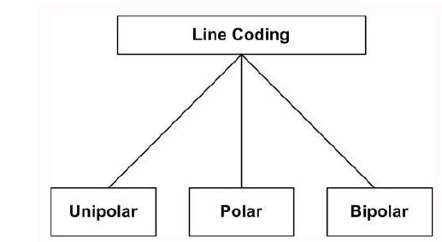
Line Coding Techniques
Line coding techniques can be broadly divided into three broad categories:
Unipolar, Polar and Bipolar

Slide 19
Unipolar
Only two voltage levels are used.
It uses only one polarity of voltage level
Bit rate same as data rate.
Disadv: DC component present in the encoded signal
Loss of synchronization for long sequences of 0’s and 1’s.
Adv: It is simple but obsolete.

Slide 20
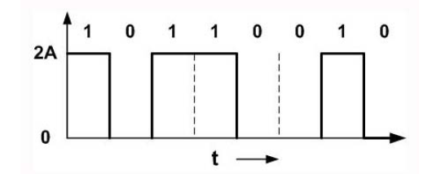
Unipolar

Slide 21
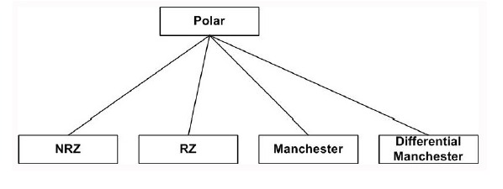
Polar
It uses two voltage levels – one positive and the other one negative.
Four different encoding schemes are available

Slide 22
Non Return to zero
Most common and easiest way to transmit digital signals is to use two different voltage levels for the two binary digits.
A negative voltage is used to represent one binary value and a positive voltage to represent the other.
The data is encoded as the presence or absence of a signal transition at the beginning of the bit time.

Slide 23
Non Return to zero
In NRZ encoding, the signal level remains same throughout the bit-period.
There are two encoding schemes in NRZ: NRZ-L and NRZ-I,

Slide 24
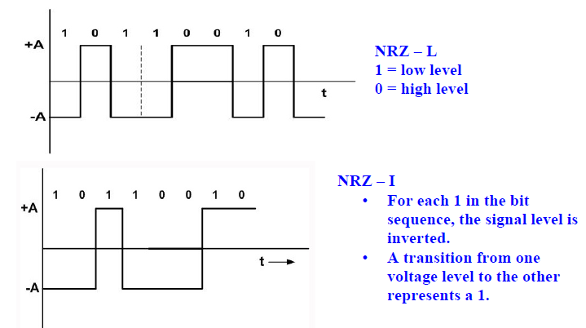
NRZ-L and NRZ-I
NRZ-L | NRZ-I
level of voltage determines the value of bit | change or lack of change in level of voltage determines value of bit.

Slide 25
Advantages of NRZ coding
Detecting a transition in presence of noise is more reliable than to compare a value to a threshold.
NRZ codes are easy to engineer
It makes efficient use of bandwidth.

Slide 26
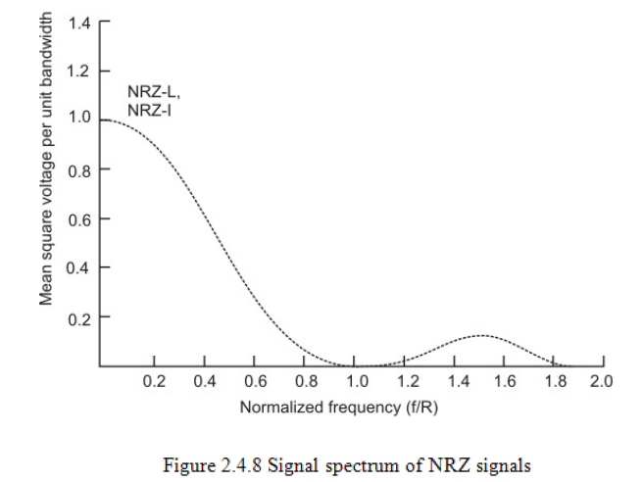
Spectrum of the NRZ-L and NRZ-I signals
Most of the energy is concentrated between 0 and half the bit rate.

Slide 27
Limitations of NRZ coding
Presence of a dc component
Lack of synchronization capability.
When there is long sequence of 0’s or 1’s,
the receiving side will fail to regenerate the clock
and synchronization between the transmitter and receiver clocks will fail.

Slide 28
Return to Zero (RZ)
To ensure synchronization, there must be a signal transition in each bit.
Key characteristics of the RZ coding are:
Three levels
Bit rate is double than that of data rate
No dc component
Good synchronization
Main limitation is the increase in bandwidth

Slide 29
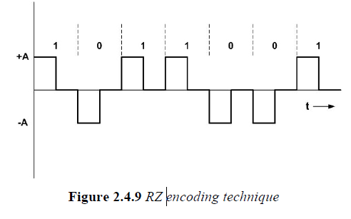
Return to Zero

Slide 30
Biphase
To overcome the limitations of NRZ encoding, biphase encoding techniques can be adopted.
Two common Biphase techniques are:
Manchester Coding
Differential Manchester

Slide 31
Manchester coding
A transition at the middle of each bit period.
This mid-bit transition serves as a clocking mechanism and also as data.
A binary 1 corresponds to a low-to-high transition and
a binary 0 to a high-to-low transition in the middle.

Slide 32
Differential Manchester Coding
Inversion in the middle of each bit is used for synchronization.
The encoding of a 0 is represented by the presence of a transition both at the beginning and at the middle (next bit 0 inversion)
and 1 is represented by a transition only in the middle of the bit period. (next bit 1 no inversion)

Slide 33
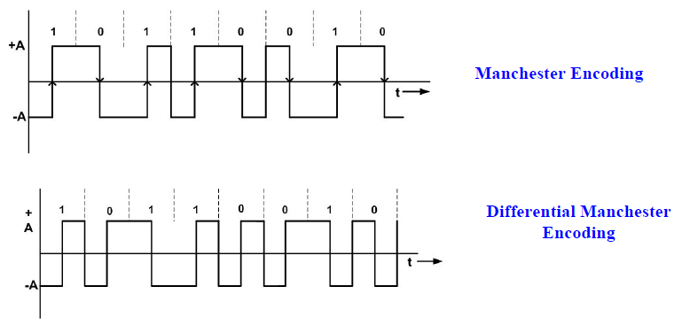
Cont..

Slide 34
Key characteristics
Two levels
No DC component
Good synchronization
Disadv:
Higher bandwidth due to doubling of bit rate with respect to data rate

Slide 35
Cont..
The bandwidth required for biphase techniques are greater than that of NRZ techniques,
but due to the predictable transition during each bit time,
the receiver can synchronize properly on that transition.
Biphase encoded signals have no DC components.

Slide 36
Application
Manchester code is now very popular and has been specified for the IEEE 802.3 standard
for base band coaxial cables and twisted pair CSMA/CD bus LANs.

Slide 37
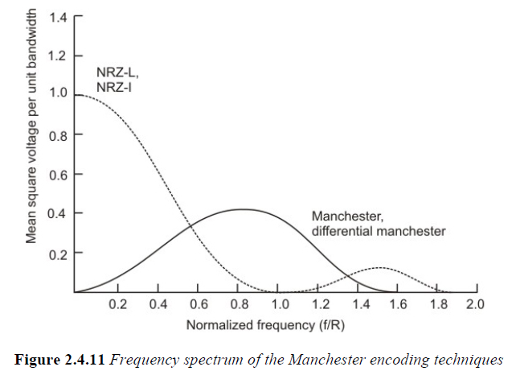
Signal Spectrum

Slide 38
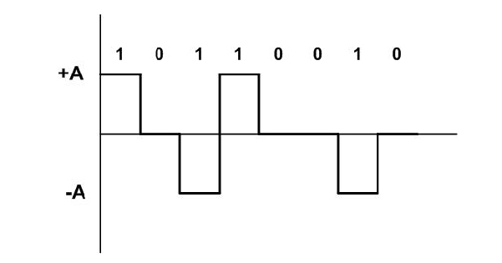
Bipolar Encoding :AMI
AMI uses 3 voltage levels.
Unlike RZ, 0 level is used to represent a 0
A binary 1’s are represented by alternating +ve and –ve voltages.

Slide 39
Pseudoternary
This scheme is same as AMI.
But alternating +ve & –ve pulses occur for binary 0 instead of binary 1.
Key characteristics are:
3 levels
No DC comp
Loss of synchronization for long sequences of 0’s

Slide 40

Modulation Rate
Data rate (R) is expressed in bits per second.
Modulation rate (D)is expressed in bauds.
General relationship between 2 are:
Where D is the modulation rate in bauds
R is data rate in bps
L is the number of different signal elements
b is the number of bits per signal element.
;

Slide 41
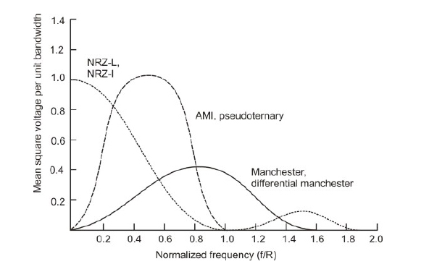
Frequency Spectrum

Slide 42
Power Spectral Density of Various Line coding formats

